Slide 1
Operating systems
General overview

Slide 2
Structure of Software:
Application Software
System Software
Operating System
HARDWARE

Slide 3
What is Operating System?
OS is a software, which makes a computer to actually work.
The OS organizes and controls the hardware.
It is the software the enables all the programs we use.
OS acts as an interface between the application programs and the machine hardware.

Slide 4
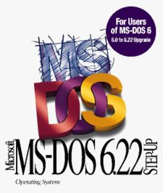
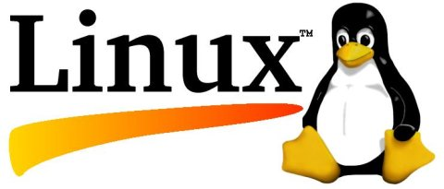

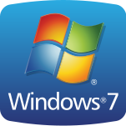
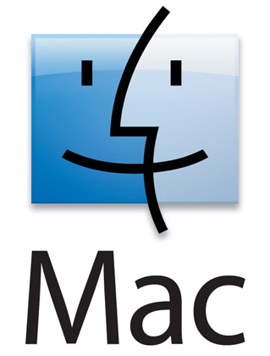
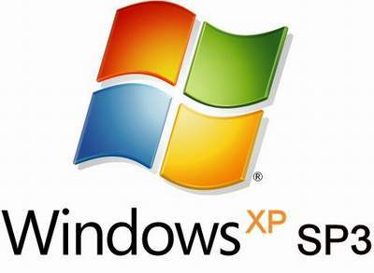
Examples of Operation Systems:
Windows (MS-DOS, 95, Millennium, XP, Vista, 7)
Mac OS
OS/2 Warp
Linux
And many others

Slide 5

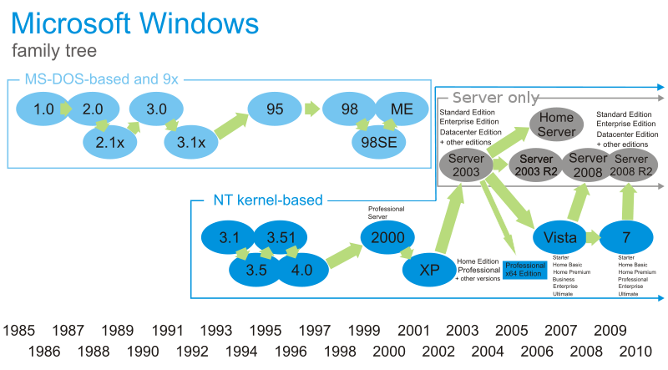
Developer: Microsoft
Programmed in C, C++
Initial release: November 20, 1985 (as Windows 1.0)
Supported platforms: IA-32, x86-64 and Itanium
Available language(s): Multilingual

Slide 6
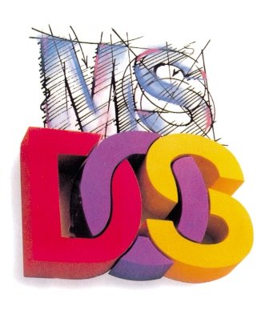
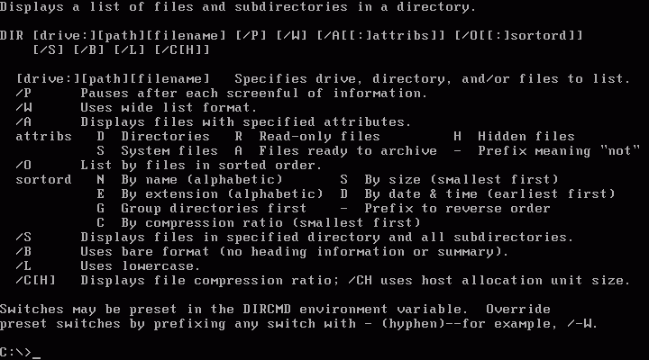
MS-DOS (short for MicroSoft Disk Operating System)
For x86-based personal computers
Developed in 1981 for IBM Computers
OS with a command line interface
Today, MS-DOS is rarely used

Slide 7
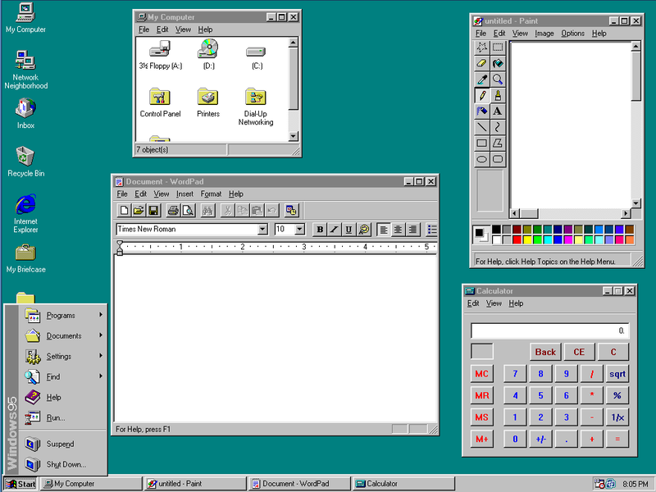
Windows 95, 2000, Millennium
In Windows 95 Internet becomes a part of the UI
Windows 2000 is build upon the windows NT architecture and designed for business uses
Windows Millennium designed for home use. It includes support for DVD, music players and mobile computers

Slide 8
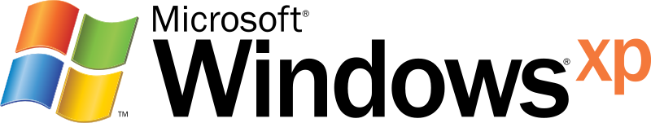
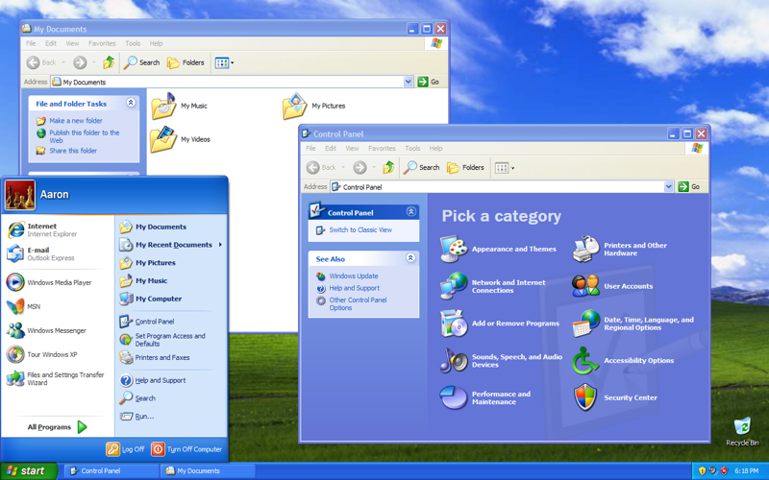
Release date: August 24, 2001
Is an update to all Windows versions
Produced for use on personal computers
Has new design
More secure and reliable
The most use OS of Windows family

Slide 9

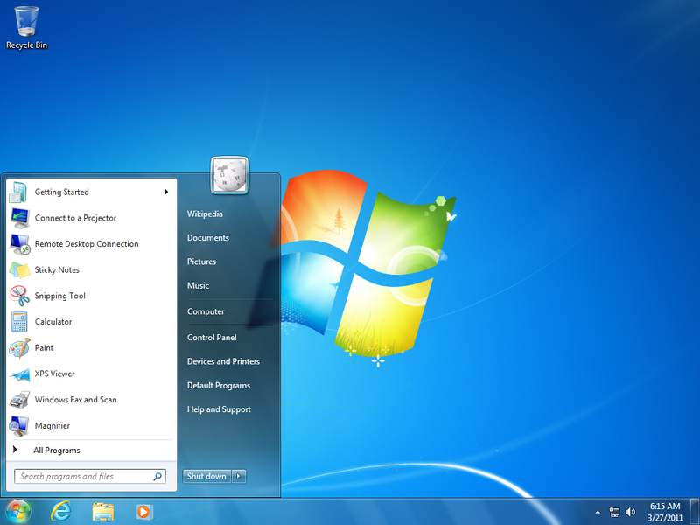
Release date: July 22, 2009
Is the latest release of MS Windows
Including home and business desktops, laptops, netbooks, tablet PCs, and media center PCs
Includes a number of new features, such as advances in touch and handwriting recognition, support for virtual hard disks, improved performance on multi-core processors, DirectAccess, and kernel improvements

Slide 10
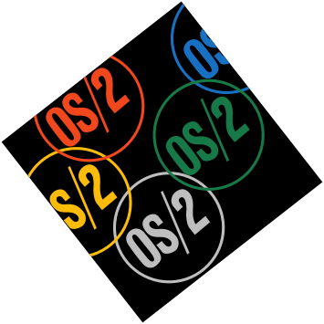
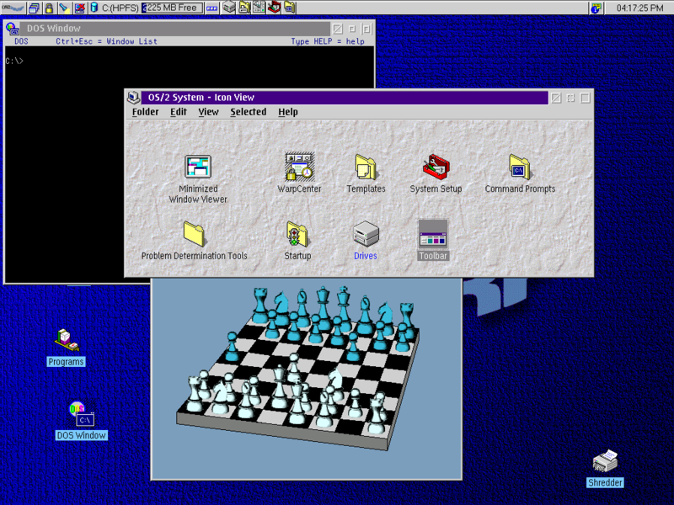
OS/2 Warp
Created by Microsoft and IBM
The most sophisticated OS
Provides multi-tasking, allowing a program to be divided into ‘threads’
OS/2 Warp includes support for Java application and voice recognition technology

Slide 11

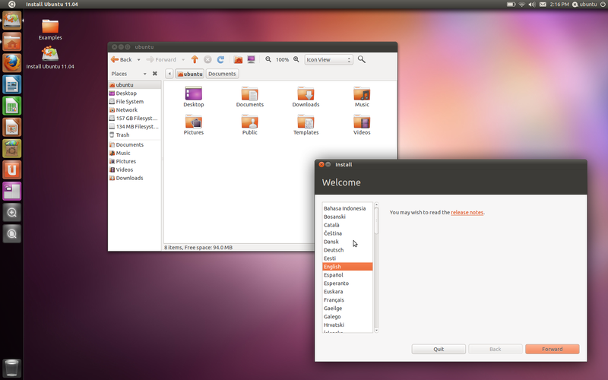
Linux
Linux refers to the family of Unix-like computer operating systems using the Linux kernel.
Developer: GNU Project, Linus Torvalds and many others
Free and open source software
Can be installed on a wide variety of computer hardware, ranging from mobile phones, tablet computers and video game consoles, to mainframes and supercomputers

Slide 12
Thanks for watching

